Slide 1
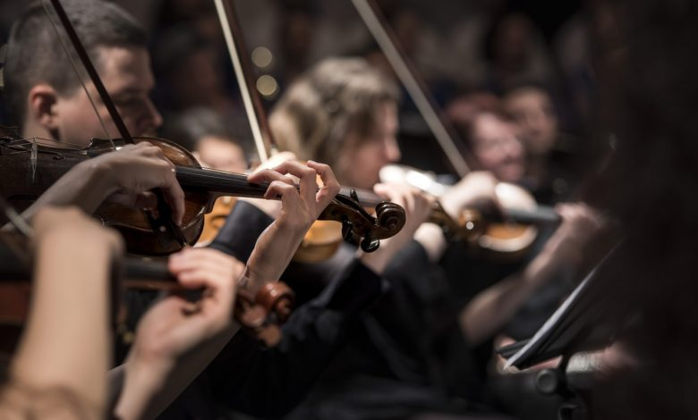
전자공학종합설계
중간발표(5/30)
Team PNP Members – 박병준, 박선우

Slide 2
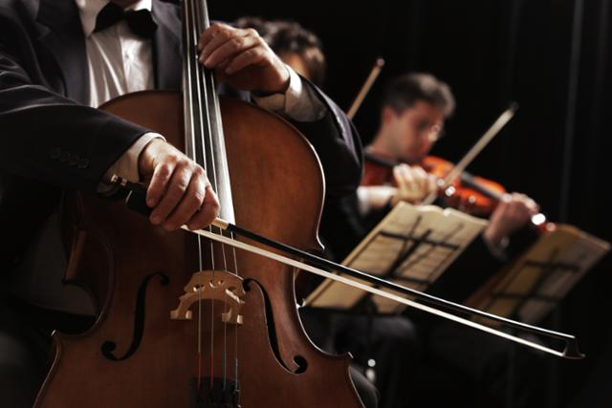
목차
지난 주 정리
관련 논문
이번 주 진행상황
다음 주 계획

Slide 3
지난 주 정리

Slide 4

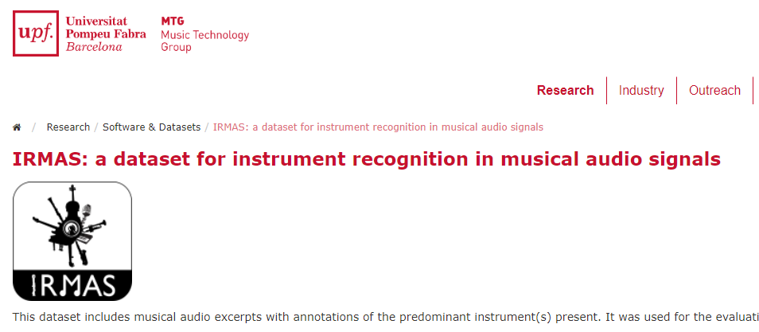

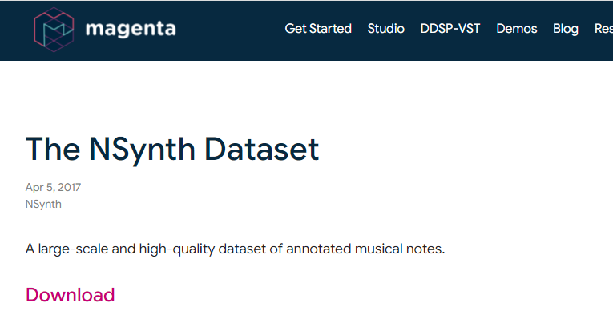
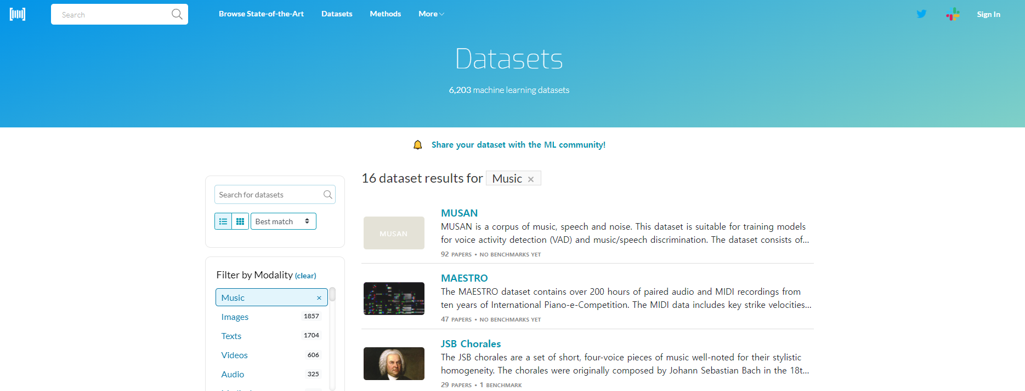
데이터셋 준비

Slide 5
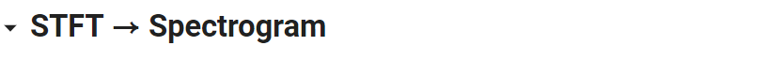
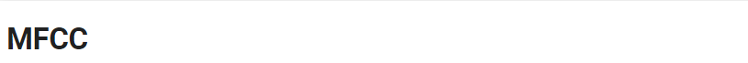
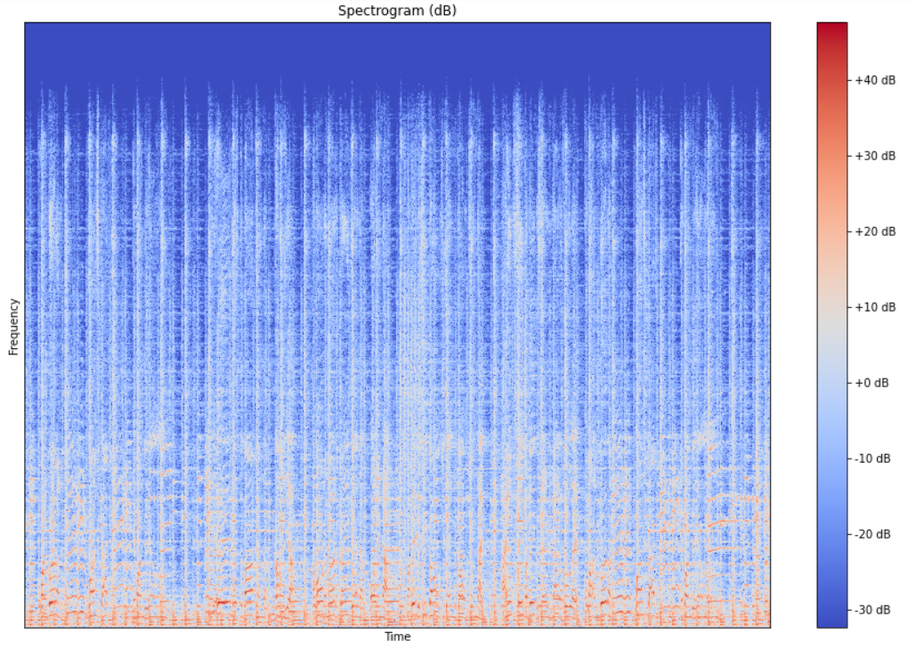
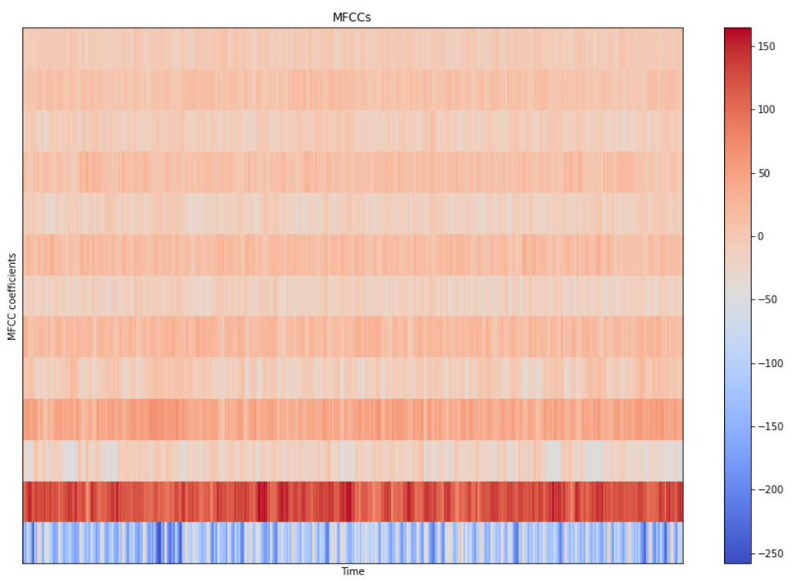
데이터셋 가공 - 실습

Slide 6
관련 논문

Slide 7
데이터셋 요구사항 고찰
MIR(Music Information Retrieval)
Dataset
Large
Freely available
Diverse
Representative of naturally occurring recordings
Polyphonic
Reference - Eric Humphrey, Simon Durand, and Brian McFee. Openmic-2018: An open dataset for multiple instrument recognition. In Proc. Of the International Society for Music Information Retrieval Conference (ISMIR), pages 438-444, Paris, France, 2018.

Slide 8

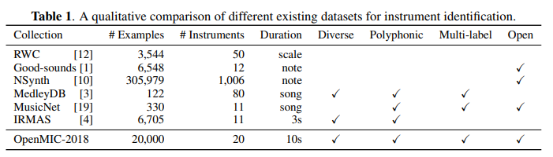


데이터 셋 비교
2017.4
2014.8
2016.10
2016.11
2014.9
2018.9
Reference - Eric Humphrey, Simon Durand, and Brian McFee. Openmic-2018: An open dataset for multiple instrument recognition. In Proc. Of the International Society for Music Information Retrieval Conference (ISMIR), pages 438-444, Paris, France, 2018.

Slide 9
데이터 셋 비교
 | IRMAS | MedleyDB Mixing Secrets | OpenMIC
Strength | Frequently used | Multi-track datasets Strong annotations | Larger sample size Uniform distribution
Weakness | Weakly labeled Lacks multi-label annotation | Hardly generalizable Not well balanced | Weakly labeled Missing labels
Reference - Siddharth Gururani, Mohit Sharma, Alexander Lerch. “An Attention Mechanism for Musical Instrument Recognition”, 20th International Society for Music Information Retrieval Conference, Delft, The Netherlands, 2019.

Slide 10
이번 주 진행상황

Slide 11
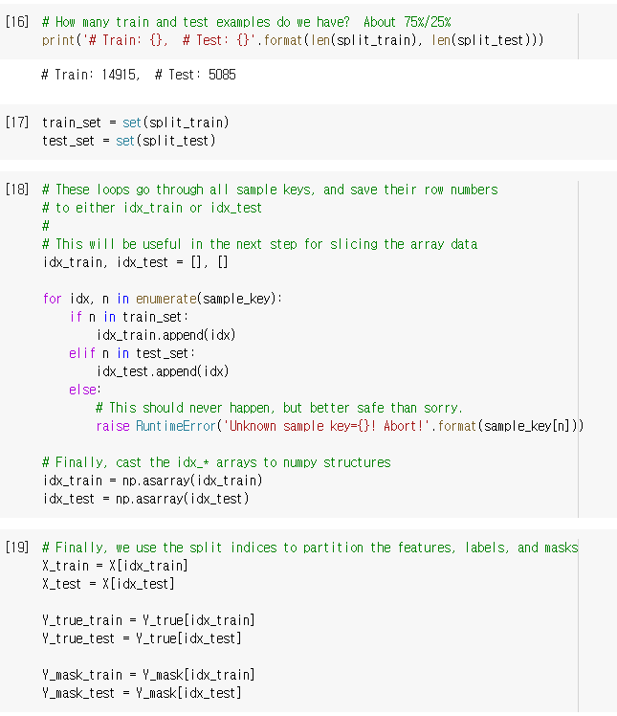
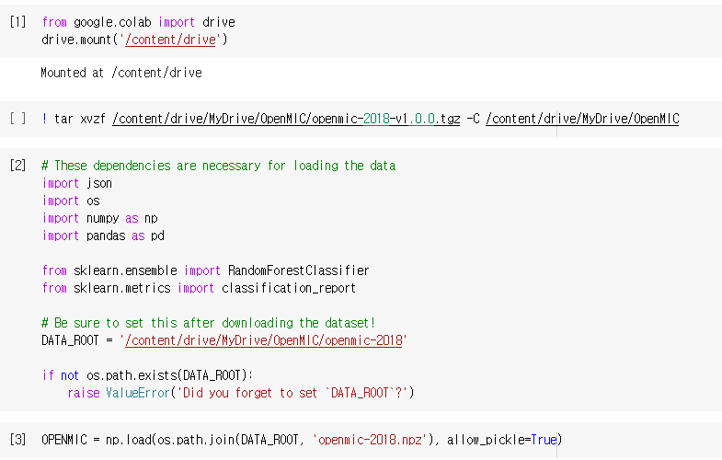
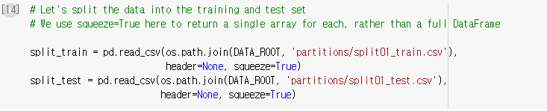
OpenMIC 불러오기

Slide 12
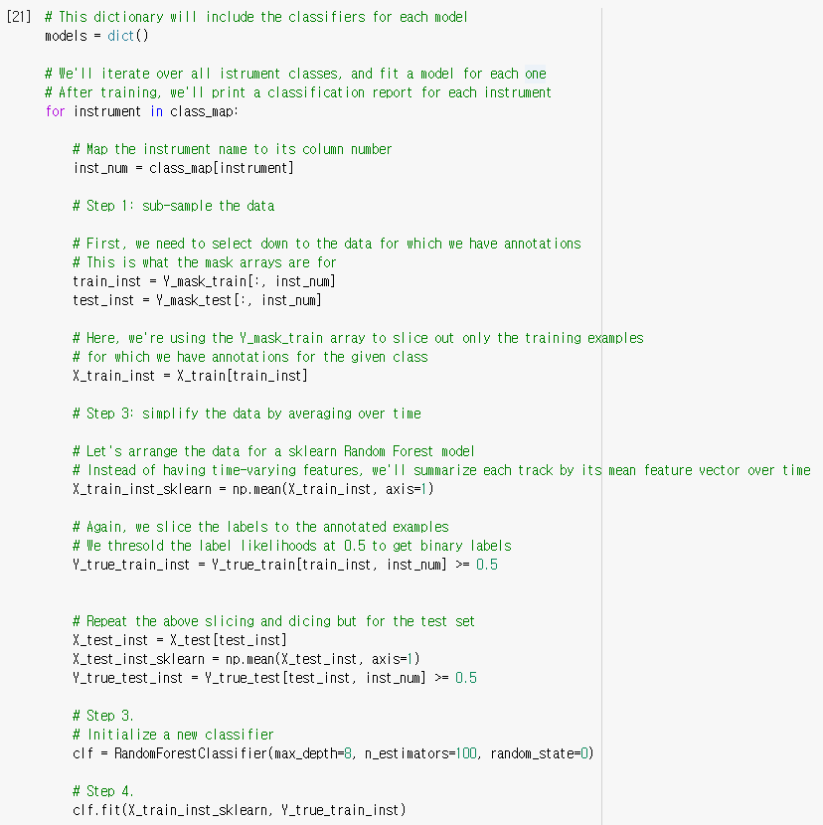
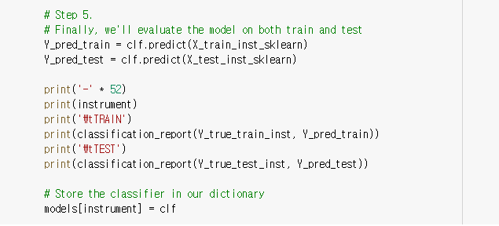
분류기에 학습시키기

Slide 13
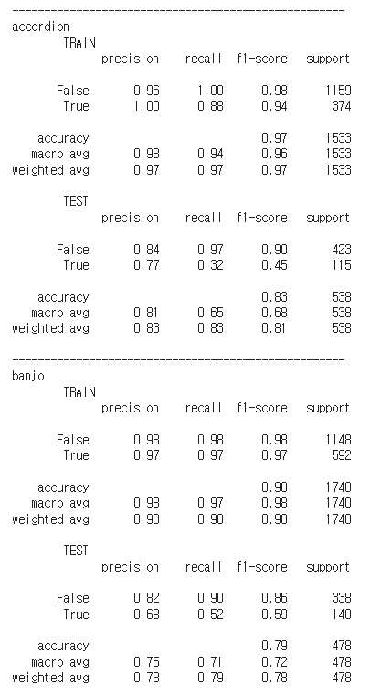
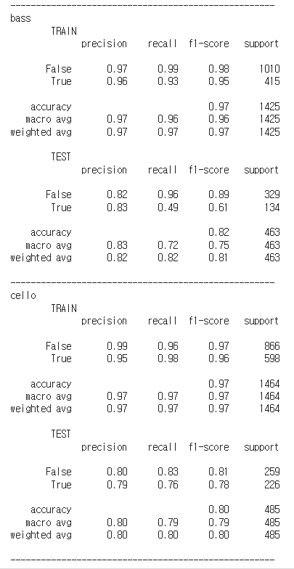
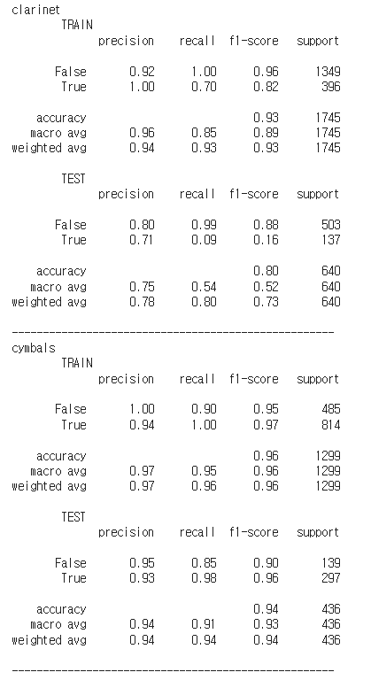

Slide 14
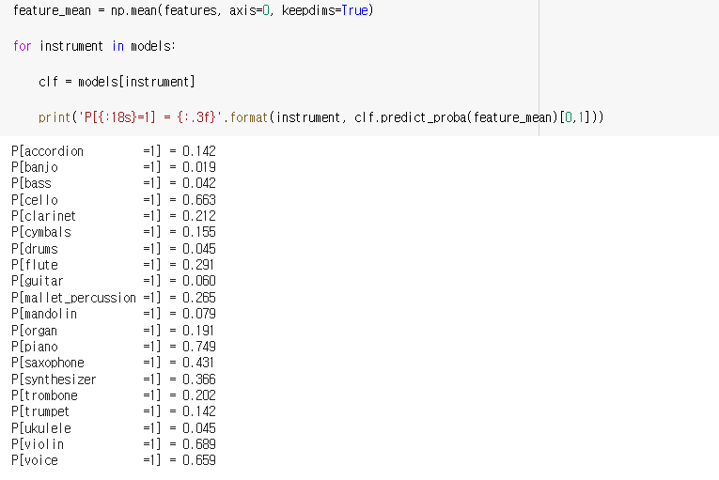
실제 음악에 테스트

Slide 15
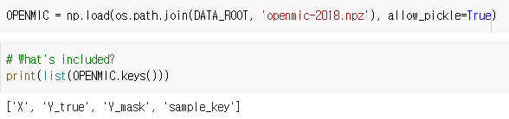
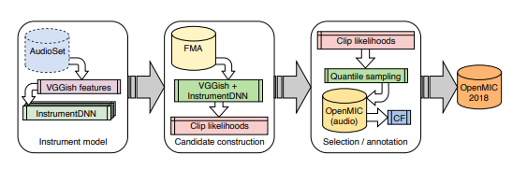
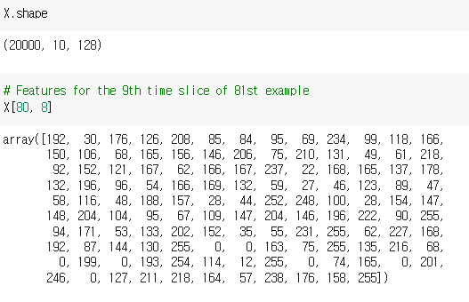
아쉬운 점 + 한계

Slide 16
다음 주 계획

Slide 17
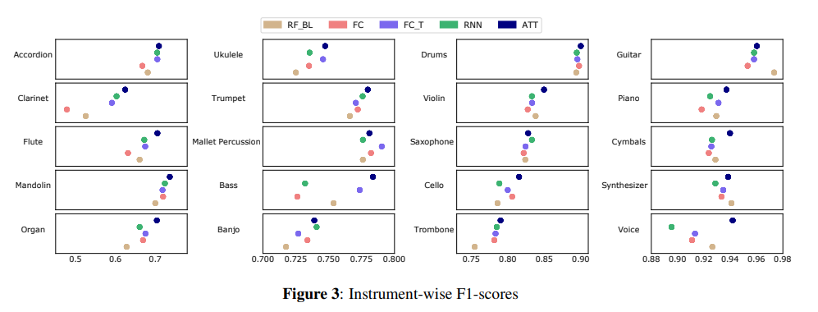
다양한 딥러닝 모델 적용
Reference - Siddharth Gururani, Mohit Sharma, Alexander Lerch. “An Attention Mechanism for Musical Instrument Recognition”, 20th International Society for Music Information Retrieval Conference, Delft, The Netherlands, 2019.

Slide 18
Q&A

